Slide 1
The Java Counters
Munayem Ahad, Dana Bradley, Adnan Vaktapuriya

Slide 2
TimeLine: The Java Counter
Week 1
Week 3
Week 2
Week 4
Research Different Calorie Counting Applications
Create a table that calculate users recommended daily intake.
Timeframe:
1 Month
Test Application and create presentation.
Create a log in page with options to sign in account and view personal dashboard.

Slide 3
01.
INTRODUCTION TO US Health Habits
Nationally 41.9% of adults have obesity.

Slide 4
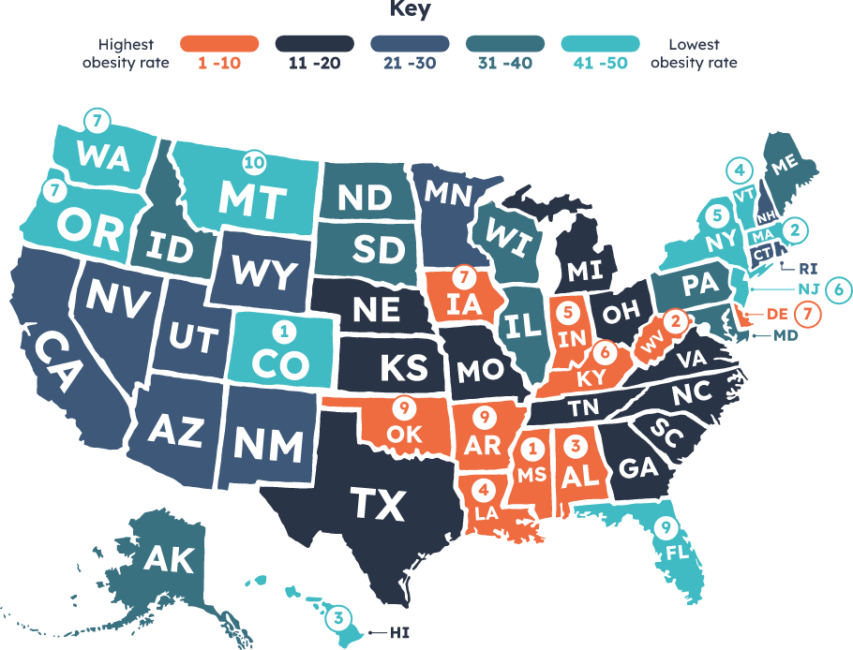
DID YOU KNOW THIS?

Slide 5
Food Mood
Foods That Increase Energy
Foods before Bedtime
Oatmeal, Bananas, Yogurt, Sesame seeds, Cinnamon, Water And Beans
Almonds, Turkey,, Kiwi, cherry juice, Fatty fish, Walnuts, Passionflower tea

Slide 6
INTRODUCTION TO JAVA COUNTERS
Calculates recommended Calorie intake
Set Goals
Displays Daily macros
Become Healthier

Slide 7
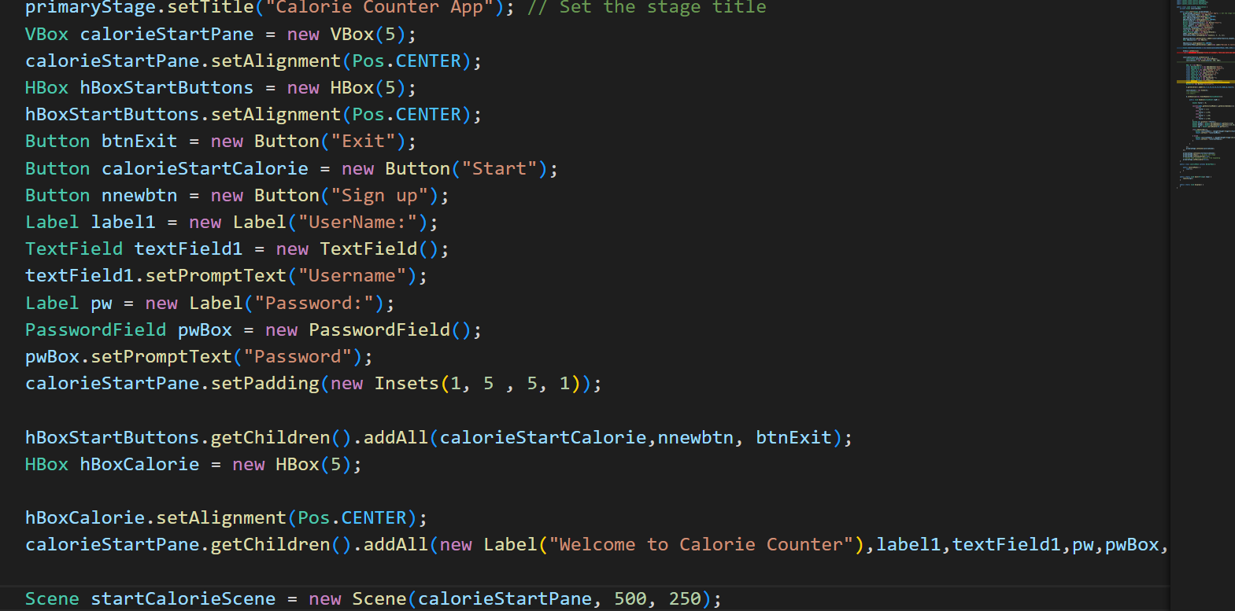
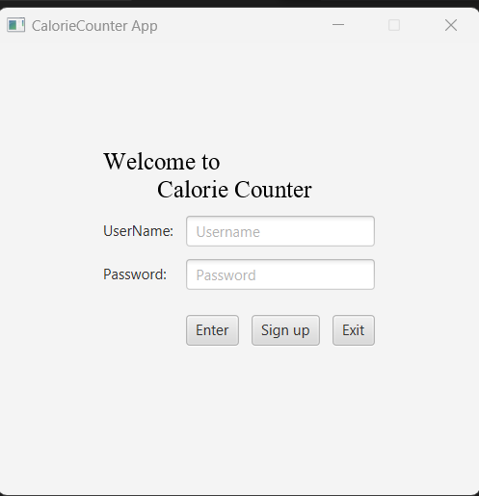
Live Code Demo

Slide 8
02
The Future Of The Java Counter

Slide 9
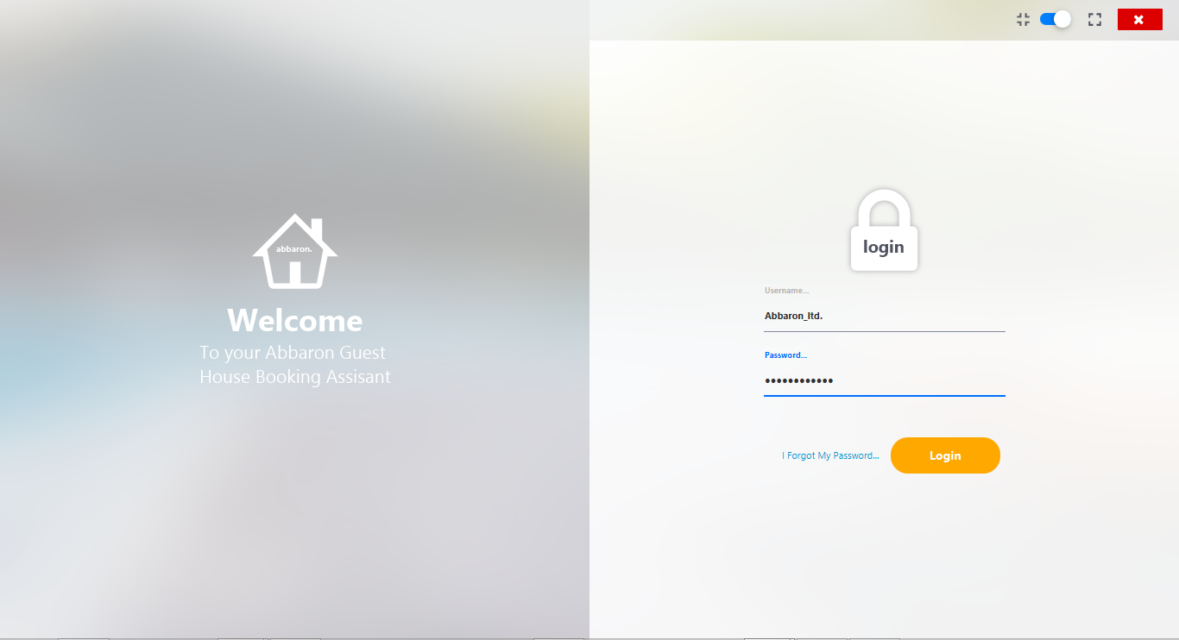
New Log in Page
The Java Counters

Slide 10
Impove the GUI!
Format
Style
Functionality
Make Application Bigger
Introuduce a New Intuitive Color Pallet
Add Shortcut Buttons and Dropdown Menu

Slide 11
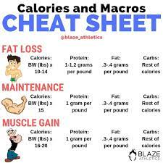
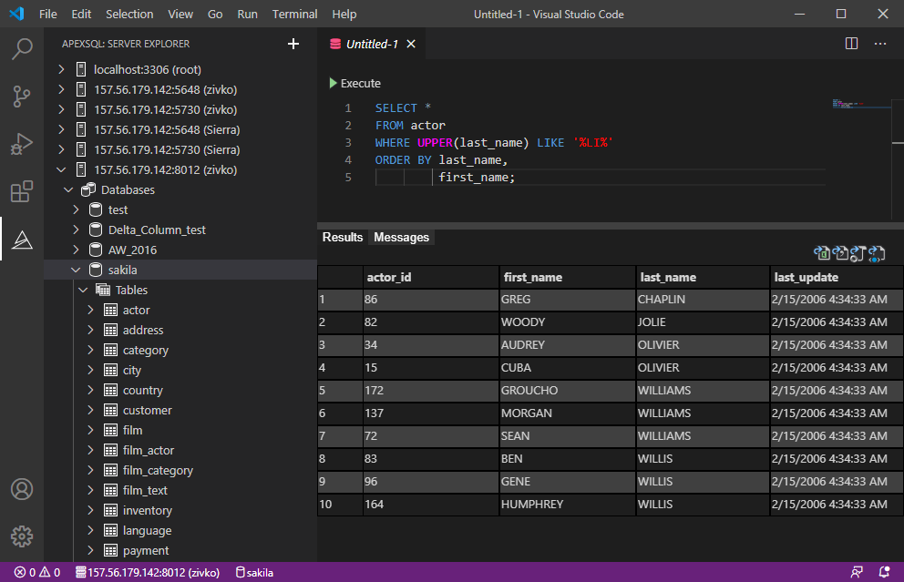
Create A Database Displaying Calories

Slide 12
Work Cited
S.Kadam, R. (1963, October 1). How to fix javafx - tableview size to current window size. Stack Overflow. Retrieved November 29, 2022, from https://stackoverflow.com/questions/38912047/how-to-fix-javafx-tableview-size-to-current-window-size
YouTube. (n.d.). YouTube. Retrieved November 21, 2022, from https://www.youtube.com/@thenewboston/videos.
YouTube. (n.d.). YouTube. Retrieved November 21, 2022, from https://www.youtube.com/@cottrellcoding3665.

